Slide 1
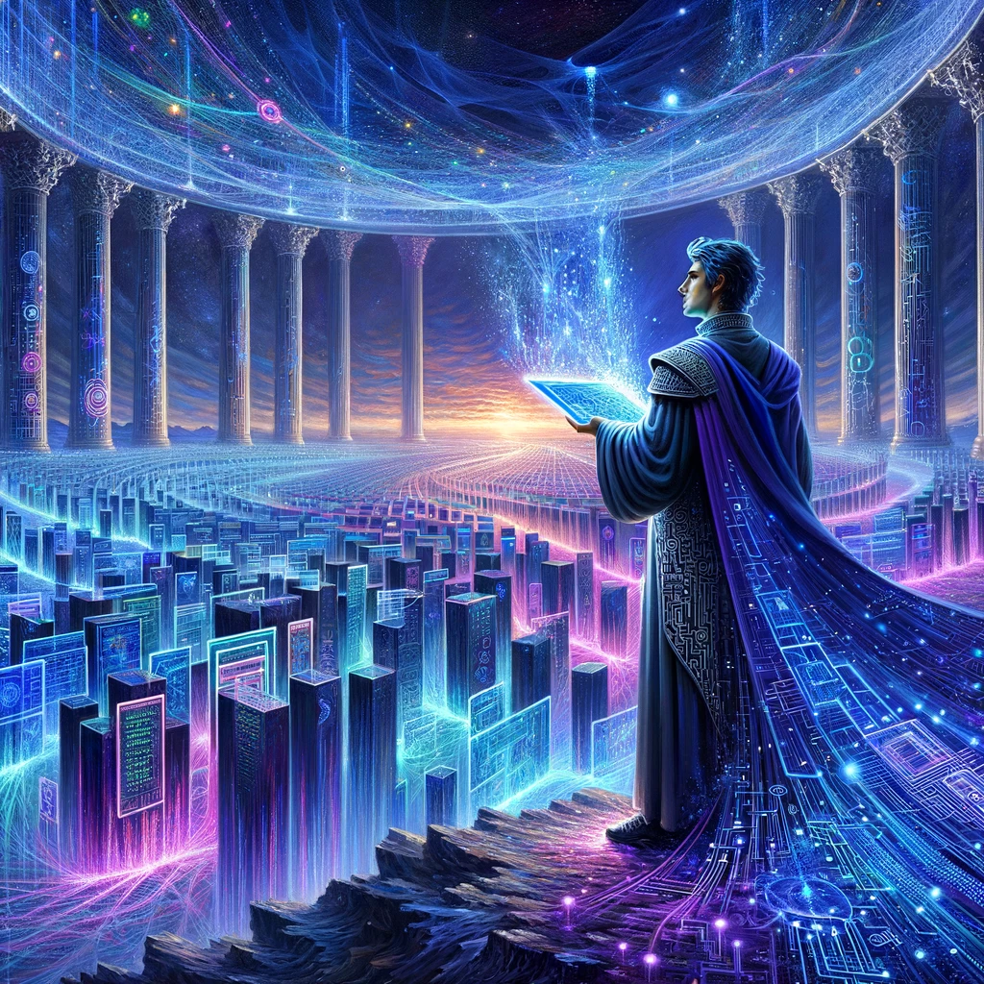
Browsing
Notes:
Search the web for Anthropic Claude 3 Opus best prompts

Slide 2
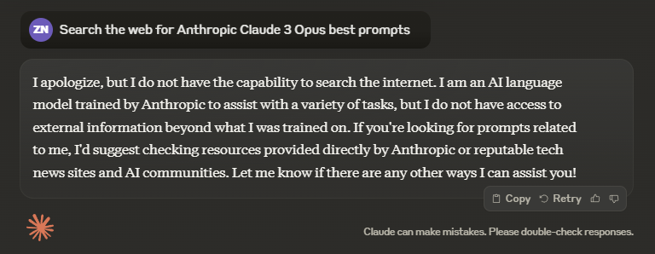

Slide 3
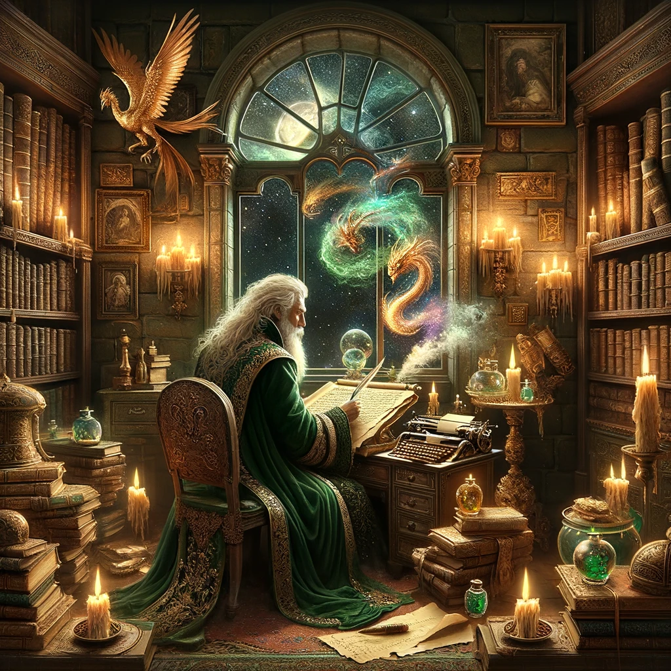
Image Generation
Notes:
Create a landscape view image of what I would see if I were looking at Earth from the surface of Mars.
Create an image of a dystopian cityscape with the word “Dystopian” written big and floating in the sky.

Slide 4
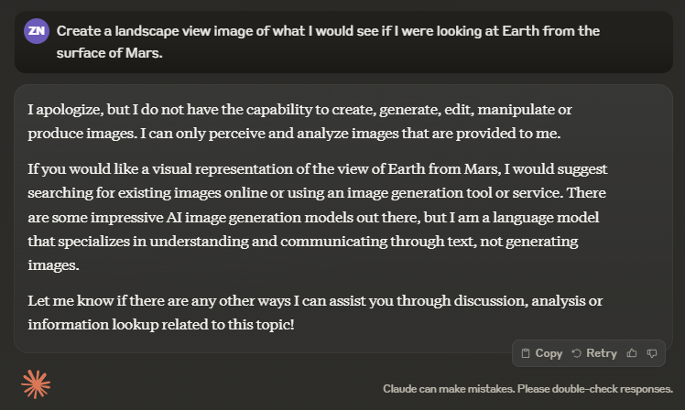

Slide 5

Data Analysis
Notes:
Look at this data and do a full data analysis with all data possible.

Slide 6
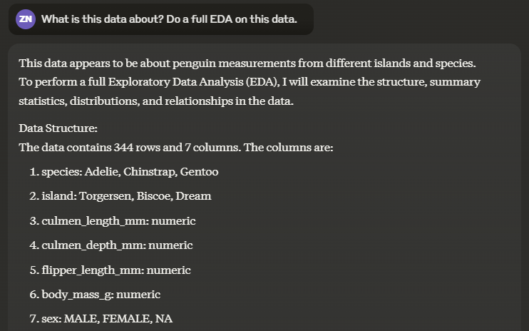
Notes:
https://www.kaggle.com/datasets/parulpandey/palmer-archipelago-antarctica-penguin-data

Slide 7
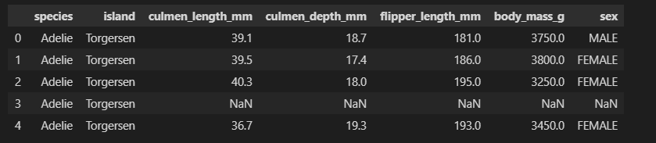
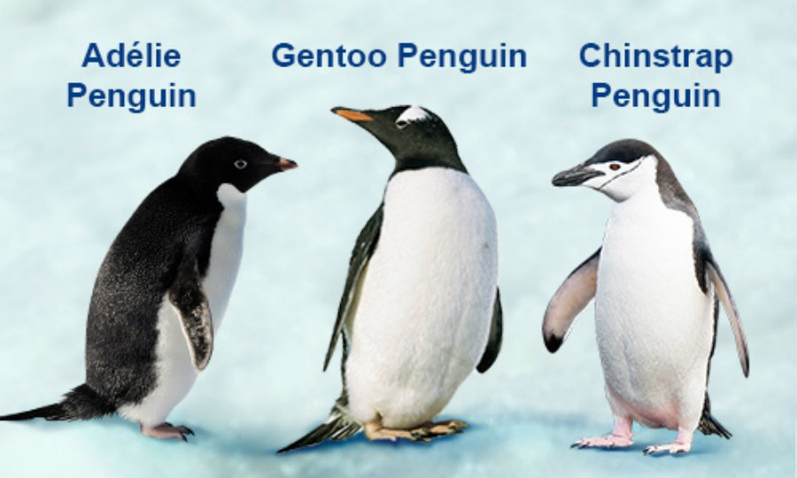
Notes:
https://www.analyticsvidhya.com/blog/2022/04/data-exploration-and-visualisation-using-palmer-penguins-dataset/

Slide 8
